Slide 1

Educator Evaluation 2024-25
What You Need to Know
Kate Field, EdD
Teacher Development Specialist
Connecticut Education Association
Katef@cea.org

Slide 2
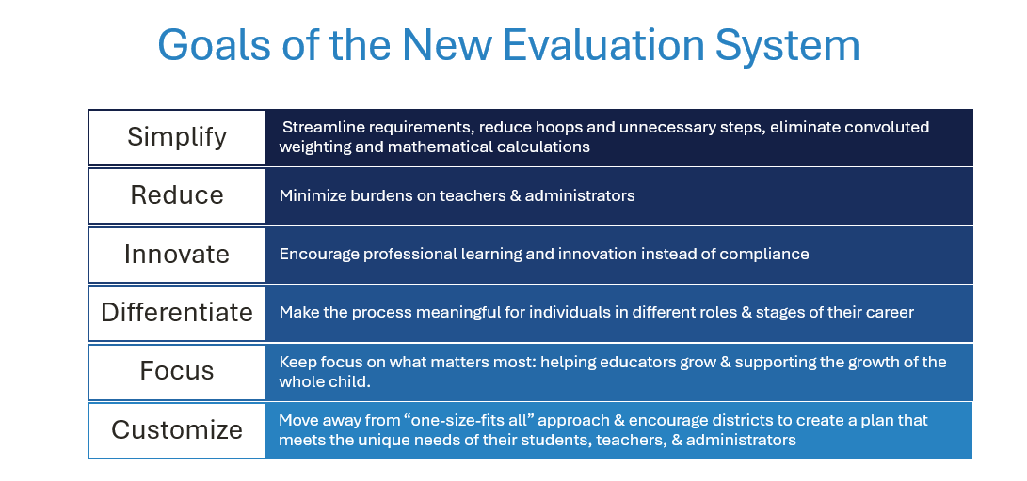

Slide 3
New Guidelines = More Flexibility for Districts
Requirements
Flexibility

Slide 4
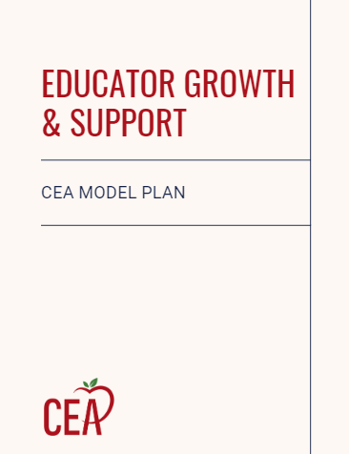

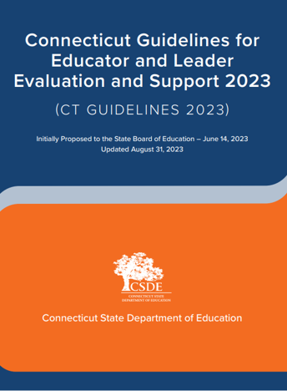


Click Here
Click Here
Click here
Your district is legally required to provide an orientation to the new plan before evaluations can begin.
Your district’s plan must be approved by your BOE and the SDE
Your district’s plan must align with the Connecticut Guidelines for Educator and Leader Evaluation and Support linked above.
Your evaluation and PD plans should be revised each year by your PDEC.

Slide 5
Requirements: | Flexibility (PDEC mutually decides):
PDEC must have collective bargaining representative(s) & create and mutually agree to plan. SDE and BOE must approve it no later than September 2024. | Observations—what are they, how long are they, do all educators need one every year, are pre and post conferences required?
Goals must be mutually agreed to & have an impact on students. | Will goals be professional learning goals? Will SLOs remain an option teachers who want them? How will goal progress be measured? Should goals be annual or span multiple years?
Rubrics must be standards based | What rubric should be selected? Should the rubric have performance ratings or levels? Should the rubric be modified?
Evaluators must have 092 | How often should evaluators be trained & calibrated?
Evaluations are confidential | What evaluation platform to use (if any)
Must include educator self-reflection | Feedback—how much and when should it be provided?
Goal setting-conference, mid-year, summative conferences are required. Summative form must include a box designating successful completion of process. | What constitutes “successful completion?”
Support plan process that requires collective bargaining role. | What will the support plan process look like?
Dispute resolution process & right to grieve procedure | How will parent or community feedback be used if at all?

Slide 6
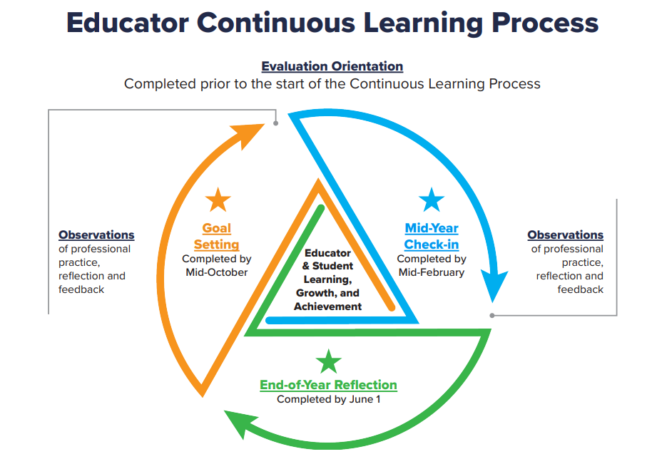
State Model Educator Evaluation Plan

Slide 7
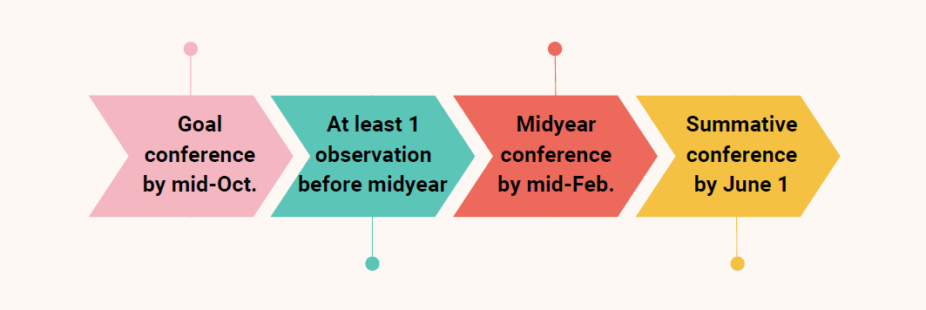
Annual Timeline
*Districts may modify deadlines somewhat as long as they remain in the same general timeframe.

Slide 8
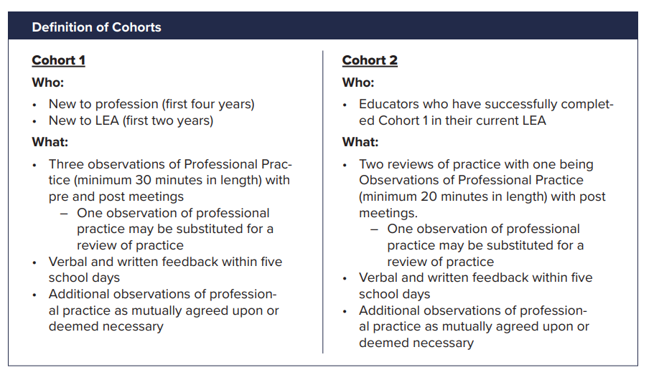
State Model Observations
*Your district PDEC may have created slightly different observation requirements than the state model. It is important to attend your district orientation and read your district’s plan to learn if your district has different requirements. Your local leadership is also encouraged to modify this presentation to include your district’s specific requirements.

Slide 9
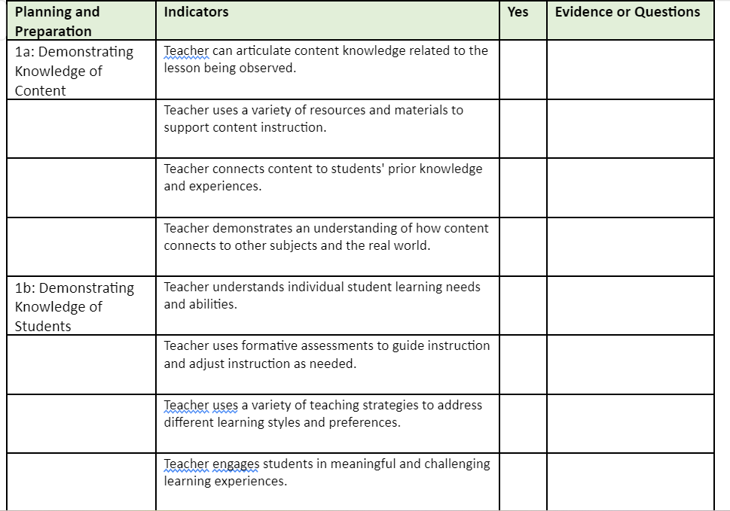
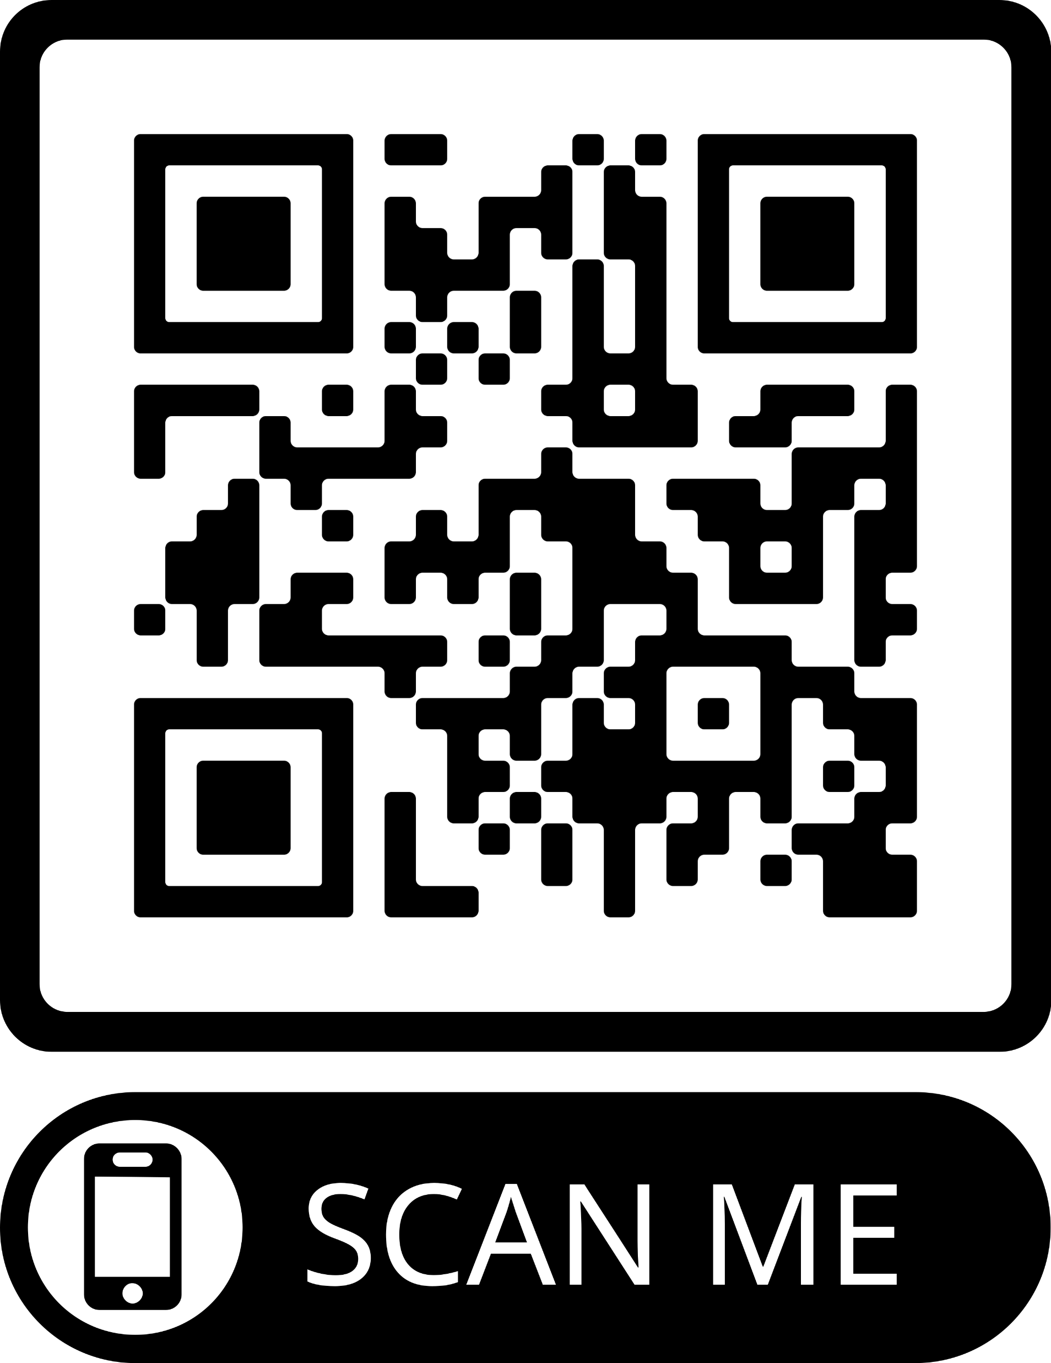
Growth without Ratings
Single Competency Rubrics
Quality Feedback Matters
Accomplishments/Celebrations:
Warm, inviting classroom atmosphere
Clear routines and transitions
Strong content knowledge
Next Steps:
Incorporate more opportunities for students to develop autonomy
Attend PD or read a book on developing student autonomy
Engage in peer observation and “borrow” a strategy on fostering autonomy.
Click here for
An example
*Your district does not have to use single competency rubrics, although state guidelines strongly encourage them. Your district PDEC may also have created its own rubrics, provided they are based on external teaching and learning or other professional standards.

Slide 10

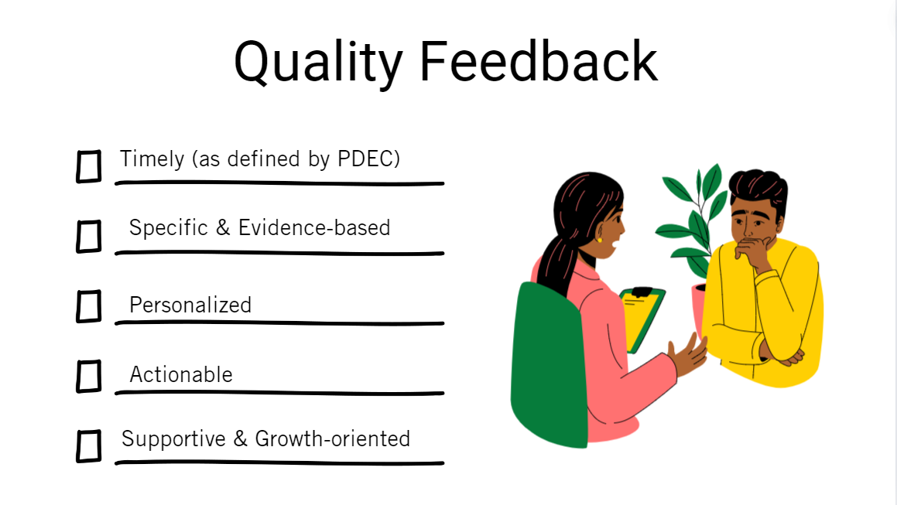

Slide 11
Dispute Resolution Process

Slide 12

Educator Goals
Must be mutually agreed upon
Only 1 goal is required
The goal does not need to mathematically quantifiable
A minimum of two indicators or measures of accomplishment are required and must be agreed upon
Goals may be professional growth goals, but must still show impact on student academic growth and development or on the school community—may have SEL or engagement focus
Teachers who are in the TEAM program may align their goal to a TEAM goal
Tenured teachers may set a goal from 1-3 years in duration
Goals may be collaborative and interdisciplinary in scope (for example, play-based learning).
Goals may have additional requirements specific to your district.

Slide 13
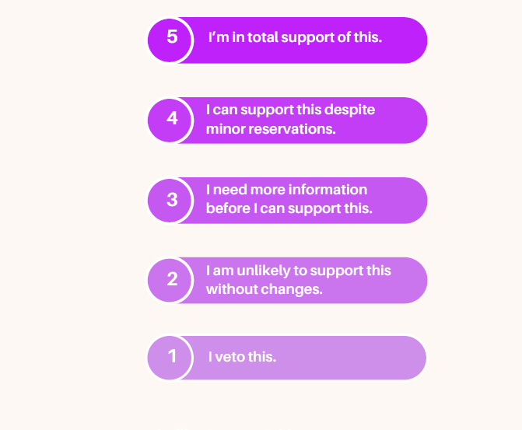
Mutual Agreement

Slide 14
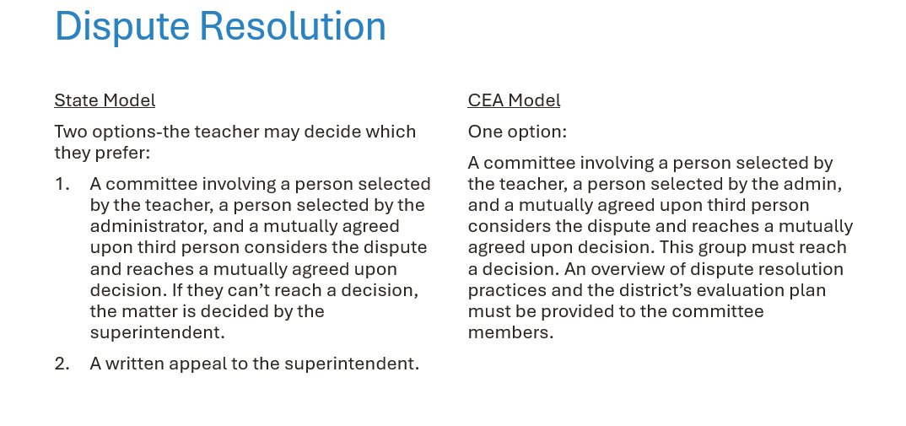

Slide 15
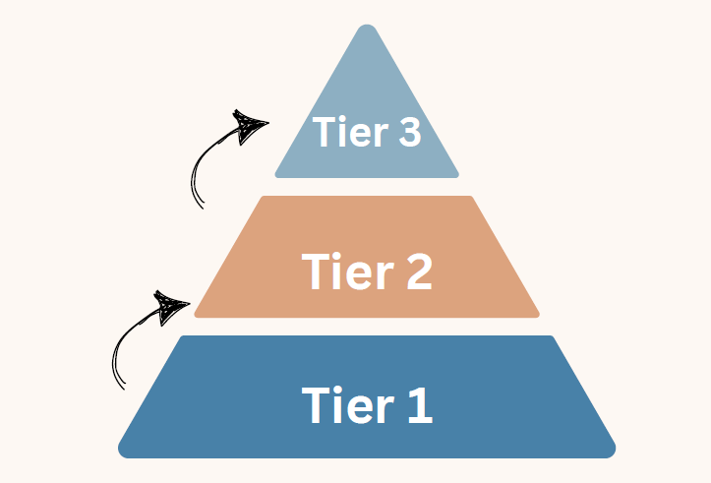
Corrective Action/Support Plan Process
Before a teacher can be placed on a support/corrective action plan, they must be provided with three tiers of informal support to help them improve. It is important that the union be involved in this process as early as possible (state guidelines require the union be contact prior to implementation of tier 3 supports).

Slide 16
Corrective Action/Support Plan Process
State Model
CEA Model
All 3 tiers of support must be provided and documented prior to the development of a formal plan
Modeled on SRBI
Tier 1 supports are provided to everyone & include things like PD, books, coaching, etc.
Tier 2 supports are provided in response to ongoing concerns that have persisted despite individualized support
Tier 3 are more intensive supports for serious concerns that do not improve despite tier 2 supports and must involve collective bargaining.
A support plan may have only one level but must be created in consultation with the teacher and their collective bargaining representative. The plan can be extended.
Three tiers of informal support provided prior to a formal plan.
Formal plans have three scaffolded levels. A formal plan can only be considered only if:
  The summative form indicates the annual process was not completed successfully
  A pattern of ongoing concerns is documented over time.
  Tiers of informal support documented.
  Concerns have persisted despite attempts at support
  Collective bargaining was notified of concerns prior to consideration of a plan
Collective bargaining must be involved.
Each level of plan can be extended if progress is documented even if the criteria for successful completion is not met.
A teacher must move through all three levels sequentially before moving to termination.

Slide 17

Questions
Contact Kate Field at Kfield@cea.org

